Slide 1
Six Types of Counseling Related Metaphors: Theory and Case Study Demonstration
International Florida Adlerian Society 17th Annual Conference
Workshop Session C4
3:15 – 4:30 PM
Daniel Eckstein, Ph.D.
Nicole Russo, MS

Slide 2

Welcome
  Introduction
  Overview of Workshop
    Early Memory Metaphors and Client-Generated Metaphors in Adlerian Therapy
    Six categories of Client-Generated Metaphors
    Six categories of Relationship Metaphors
    Applied Demonstration
    Discussion and Processing of Demonstration
    Summary and Feedback
Introduction
Overview of Workshop
  Early Memory Metaphors and Client-Generated Metaphors in Adlerian Therapy
  Six categories of Client-Generated Metaphors
  Six categories of Relationship Metaphors
  Applied Demonstration
  Discussion and Processing of Demonstration
  Summary and Feedback

Slide 3

Term derived from the Greek, meta means “above or over’ and pherein means to “carry or bear.”
  Romeo says, “Juliet is the sun.”
Creative way to draw comparisons.
Frequently occur in everyday language to express emotionally charged content.
Are used as a way to express perceptions of past, current, or future life situations.
Express one’s view of self, others, or lifestyle movement.
  “It’s a two way street.”
Clients use metaphors to express his or her inner viewpoint and emotional experience.
  “I’m sinking.”
  “I can’t climb my way out.”
  “We’re in a tug of war.”

Slide 4
Metaphors Applied to Counseling
Client-Generated Metaphors
Six Categories
Richard Kopp, Ph.D. and Daniel Eckstein, Ph.D.
Metaphors that represent one’s image of self.
Metaphors that represent one’s image of others.
Metaphors that represent one’s image of situations.
Metaphors that represent one’s understanding of the relationship between self and self.
Metaphors that represent one’s understanding of self and others.
Metaphors that represent one’s understanding of self and situations.

Slide 5
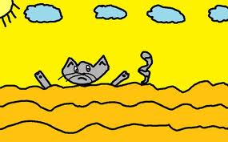

Lifestyle Movement
Category | Example
Self | I’m a teakettle about to explode!
Other | My husband’s a locomotive barging into the house.
Situation | My life is a barren wasteland.
Relationship of Self to Self | I keep beating myself up.
Relationship of Self to an Other | Dealing with him, I’m trying to tame a wild lion.
Relationship of Self to a Situation | I’m slowly sinking in quicksand.
 | Adapted from Kopp (1995, p. 104)

Slide 6
Using Early Memory Metaphors and Client-Generated Metaphors in Adlerian Therapy
  Freud saw early childhood memories as screen memories.
    The episodes recalled, by the ego, that function to “screen out” a repressed original traumatic event, if remembered, would be threatening to the ego.
  Adler regarded early recollections as the most important indicators an individual’s lifestyle (Mosak, 2002, Shulman & Mosak, 1988).
    Convey “the story of my life” from the the person’s subjective viewpoint.
    Selective memory functions in accordance with each person’s unique lifestyle.
    Individual’s remember from early childhood images that confirm or support the current views of themselves in the world (schema of apperception )
    Memories that support their directions of striving for significance and security (the law of movement or fictional lifestyle goal).

Slide 7
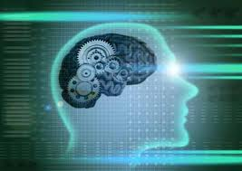



Early Recollections as Metaphors
Early recollections can function as metaphors.
Differ from linguistic metaphors.
  Spoken metaphor uses an image to convey meaning.
  Early recollections must meet certain criteria.
    They must carry meaning over from the domain of imagery to something that image refers to.

Slide 8
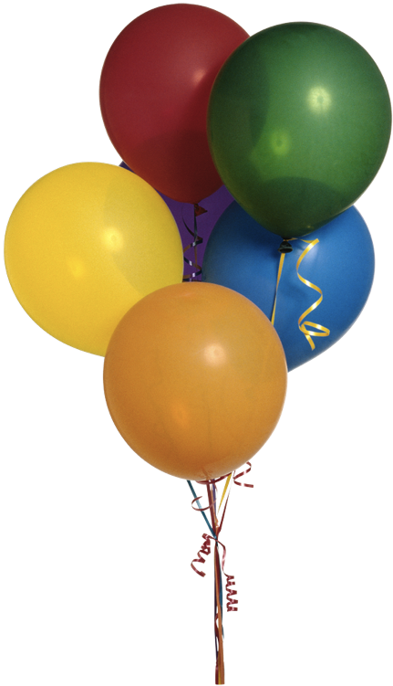

Early Recollections and One’s Lifestyle
Early memories become vehicles that carry meaning between the early memory and the current situation/problem.
  Fear of not blowing out all the candles on a birthday cake at a 7th birthday party might be viewed as a metaphor of not being up to the task.
    I am weak.
    I fear that I will be inadequate with life’s tasks.

Slide 9
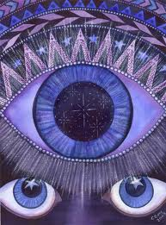
Early Recollections & Linguistic Metaphors in Adlerian Therapy
Linguistic metaphors are “word pictures” of representations of one’s lifestyle expressed in a current relationship or situation.
Express the metaphor-maker’s movement.
  “I keep running around in circles.”
  “I’m hitting my head against a wall.”
Using a structured protocol
  Exploring and Transforming Early Memory Metaphors.
  Exploring and Transforming Client-Generated Spoken Metaphors. (see handouts).
Listening with “The Third Eye.”
  Therapist introduces his or her own metaphor.
Guided Metaphor

Slide 10
EXPLORING AND TRANSFORMING EARLY MEMORY METAPHORS Interview Protocol—Short Form
^{Richard R. Kopp, Ph.D.}
STEP 1. “Where in all of this are you most stuck?” or “In what way is this a problem for you?” or “Which part of this is the biggest problem for you?”
STEP 2. “Can you remember a recent time when you felt this way? Form an image in your mind of the situation so that you begin to get the same feelings you had then, so that you actually begin to feel those feel- ings now in your body the same way you felt then.” [Pause to allow the client time to do this inner work] “Are you picturing the situation in your mind? Are you feeling the feelings in your body? Where in your body do you feel them?”
STEP 3. “What is the first early childhood memory that comes to mind right now . . . the first image from childhood that pops into your mind right now?” If no memory is recalled, say: “Take your time. Something will come.”
STEP 4. Once the person begins to describe a specific incident, ask: “What happened next? What did you (he, she) say/do then? Describe it as if you were watching a play and describing what you see.”
STEP 5. When the memory is completed, ask: “What stands out most vividly in that memory? If you had a snapshot of the memory, what instant stands out most clearly in your mind’s eye?”
STEP 6A. “How did you feel at that moment?”
STEP 6B. “Why did you feel that way?” or “Why did you have that reaction?”

Slide 11
EXPLORING AND TRANSFORMING EARLY MEMORY METAPHORS Interview Protocol—Short Form
^{Continued}
STEP 7. “If you could change the memory in any way so it would be the way you would have liked it to turn out—how would you change it?” (If the client says that it wouldn’t have happened, say, “If the memory started out the same way, create how you would have liked it to go.”)
STEP 8. Invite the client to create, in detail, a specific, changed image. “What happens next? What do you (he, she) say/do then?”
STEP 9. When the changed memory is completed, ask: “What stands out most vividly in the changed memory? If you had a snapshot of the changed memory, what instant would stand out most clearly in your mind’s eye?”
STEP 10. “How would you feel at that moment?”
STEP 11. “Why would you feel that way?” or “Why would you have that reaction?”
STEP 12A. “Now I’m going to read back your original memory one phrase or sentence at a time. What parallels do you see between the memory and the current situation?” Empathically reflect the client’s ideas.
STEP 12B. Now I’m going to read back your changed memory one phrase or sentence at a time. What parallels you do see between changed memory and the current situation? Does your changed memory suggest any helpful ideas that you might use in the current situation?
STEP 13. (optional). “May I tell you the connections that I see?” If the client agrees, then say, “Let me know which one’s seem to fit for you.”

Slide 12
EXPLORING AND TRANSFORMING CLIENT-GENERATED SPOKEN METAPHORS
^{Interview Protocol—Short Form}
^{Richard R. Kopp, Ph.D.}
^{I.} Movement from general to personal (Find the Person in the Problem)
a. In what way is this a problem for you?
b.(1) Which part of this is most difficult for you? or
(2) What’s the biggest problem? Or
(3) Where in all of this are you most stuck?
II. Movement from facts to feelings (Find the feelings behind the facts).
What are your feelings? or How do you feel? and/or What’s this (it) like for you? or What’s your experience of
^{this—how does it feel to you?}
III. Exploring and Transforming Client Metaphors
a. STEP 1. Notice metaphors! (Especially in the client’s response to the above questions.)
b. STEP 2. “When you say [repeat the metaphoric image], what image/ picture comes to mind?” or “What
image/picture do you see in your mind’s eye?”
c. STEP 3. Explore the metaphor as a sensory image:
(1) Setting [e.g., “What else do you see?” or “Describe the scene or an aspect of the scene (associated with
^{the metaphoric image)”].}
(2) action/interaction [e.g., “What else is going on in (the metaphoric image)?” or “What are the other people
(in the metaphoric image) saying/thinking/doing?”].
(3) time [e.g., “What led up to this? What was happening (just) before (the situation in the metaphor)?”
d. STEP 4. “What’s it like to be [the metaphoric image]?” or “What’s your experience of [the metaphoric
image]?” or “What are you feeling as you [the metaphoric image]?”
e. STEP 5. The therapist says, “If you could change the image in any way, how would you change it?”
f. STEP 6. “What connections (parallels) do you see between your original image that you explored and the
^{original situation?”}
g. STEP 7. “How might the way you changed the image apply to your current situation?”

Slide 13

Journey Into the Woods………..

Slide 14
Six Categories of Relationship Metaphors
Sarah Eckstein, Jennifer Straub, Nicole Russo, Daniel Eckstein
“A relationship, I think, is like a shark. You know? It has to constantly move forward or it dies. And I think what we got on our hands is a dead shark.” (Annie Hall, 1977)
Steven Sondheim 1987 Broadway musical Into the Woods
Uses familiar Brothers Grimm fairy tales to parallel life’s quests,
wishes, and challenges of finding happiness, love, and coping with
fear and the unknowns – the woods of life.
  Three parts in a relationship – “you, me, and it” or acts “stage left, stage right, and center stage (Baxter, 2003).”
  Each fairy tale character crosses over into the story line of the characters in the woods at center stage.
    Individuals meet to share his or her fairy tale or family-of-origin story.
    A blending process occurs through exploration and discovery.
    A couple blends their stories and create a united grand finale.

Slide 15
Use of Relationship Metaphors
A Couple explores his or her own family-of-origin metaphors.
Explores his or her own previous relationship metaphors.
The couples creates a new metaphoric journey of their relationship.
  Role perceptions.
  Building your concept of the relationship
  Working through problems
  Exploring central themes of your relationship
  Changing unhealthy interactions into healthier interactions
  Approach to life’s tasks.
“We are at a cross roads” “We are at dead end”
“I cannot live without her” “We are just going through motions”
“We were made for each other” “I’m flying solo”

Slide 16
Six Slices of a Relationship Metaphoric Pie
Adopted From Richard Kopp and Daniel Eckstein (2004) article, Using Early Memory Metaphors and Client- Generated Metaphors in Adlerian Therapy. Journal of Individual Psychology, 60(2), 163-174.

Slide 17

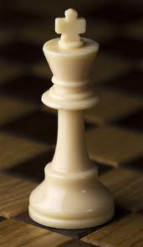
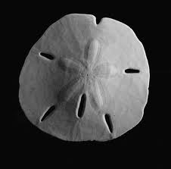
Category 1: My self-image, regardless of relationship context.
I see myself as...
I see myself as a chess piece trying to figure out my next
move.
I see myself as a ball waiting for someone to catch me.
I see myself as a rock that is strong and independent.
I see myself as a hammer and keep beating myself up.
I see myself as an endless mirror with so many roles to fulfill.
I see myself as a sand dollar with hidden treasures.
I see myself as a seed starving for water, light, and
fertilization.

Slide 18


Category 2: My self-image within the context of our relationship.
I am like a…
I am like a Facebook member, signing in and out whenever it is convenient for me and sometimes making private information too public.
I am like grass that insists on growing through the tiny cracks allowed by hard cement even though growing in the lawn with all the other grass would be much less challenging.

Slide 19
Category 3: My self-image regarding a problem in our relationship
With respect to ____ I see myself as…
When Harry Met Sally…
Harry Burns: There are two kinds of women: high maintenance and low maintenance.
Sally Albright: Which one am I?
Harry Burns: You're the worst kind; you're high maintenance but you think you're low maintenance.
Sally Albright: I don't see that.
Harry Burns: You don't see that? Waiter, I'll begin with a house salad, but I don't want the regular dressing. I'll have the balsamic vinegar and oil, but on the side. And then the salmon with the mustard sauce, but I want the
mustard sauce on the side. "On the side" is a very big thing for you.
Sally Albright: Well, I just want it the way I want it.
Harry Burns: I know; high maintenance.
(Ephron & Reiner, 1989)

Slide 20
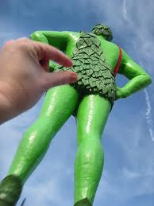

Category 4: My image of parent, role model, or partner is like…
My partner is like an express train that blows by many stops.
My partner is like a green giant always there looking over and protecting me.
My mother is like a momma bear.
My grandfather is like a wise old owl that provides that is full of insight and wisdom.

Slide 21
Category 5: My image of a general life situation (work, injury, retirement) impacting our relationship
With respect to ___, our life situation is like…
With respect to motherhood, it’s like a roller coaster with thrilling and scary ups, down, twists, and turns.
With respect to work, it’s like a ladder because I’m climbing to the top.
With respect to true love, it is like a good pair of socks, it takes two, and they've gotta match (Richardson, 2009).
With respect to family dinners, they are like landscapes a thousand acres per human heart; they erode but endure all weathers
(Richardson, 2009).
With respect to relationships, don't smother each other and let the sunlight in.
With respect to illness, it’s like a wave, you just have to ride it out.

Slide 22
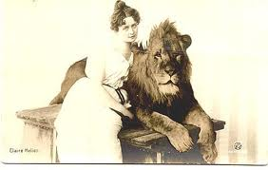

Category 6: My image of our relationship
I consider our relationship to be like…
I consider it to be like a machine that needs routine maintenance (Baxter, 2003).
I consider it to be like a computer that needs periodic upgrades.
I consider it to be like a taming a lion where I am trying to constantly control others around me.
I consider it to be like a symphony where each instrument is vital to create the harmony.
I consider it to be like a war where you win and lose battles.
I consider it to be like an adventure with each new trip is an opportunity to discover new feelings and experiences.

Slide 23
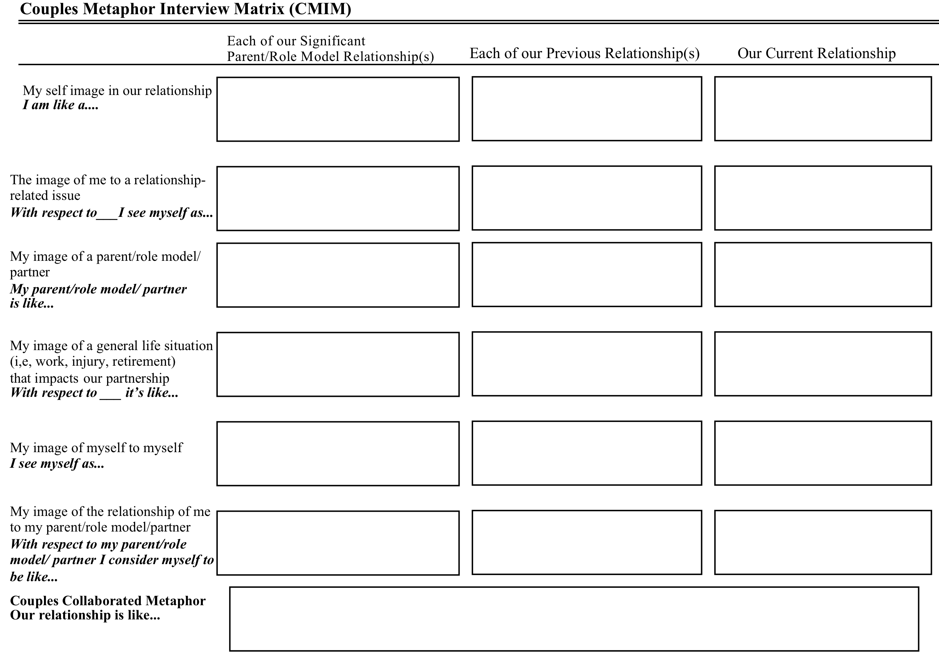

Slide 24
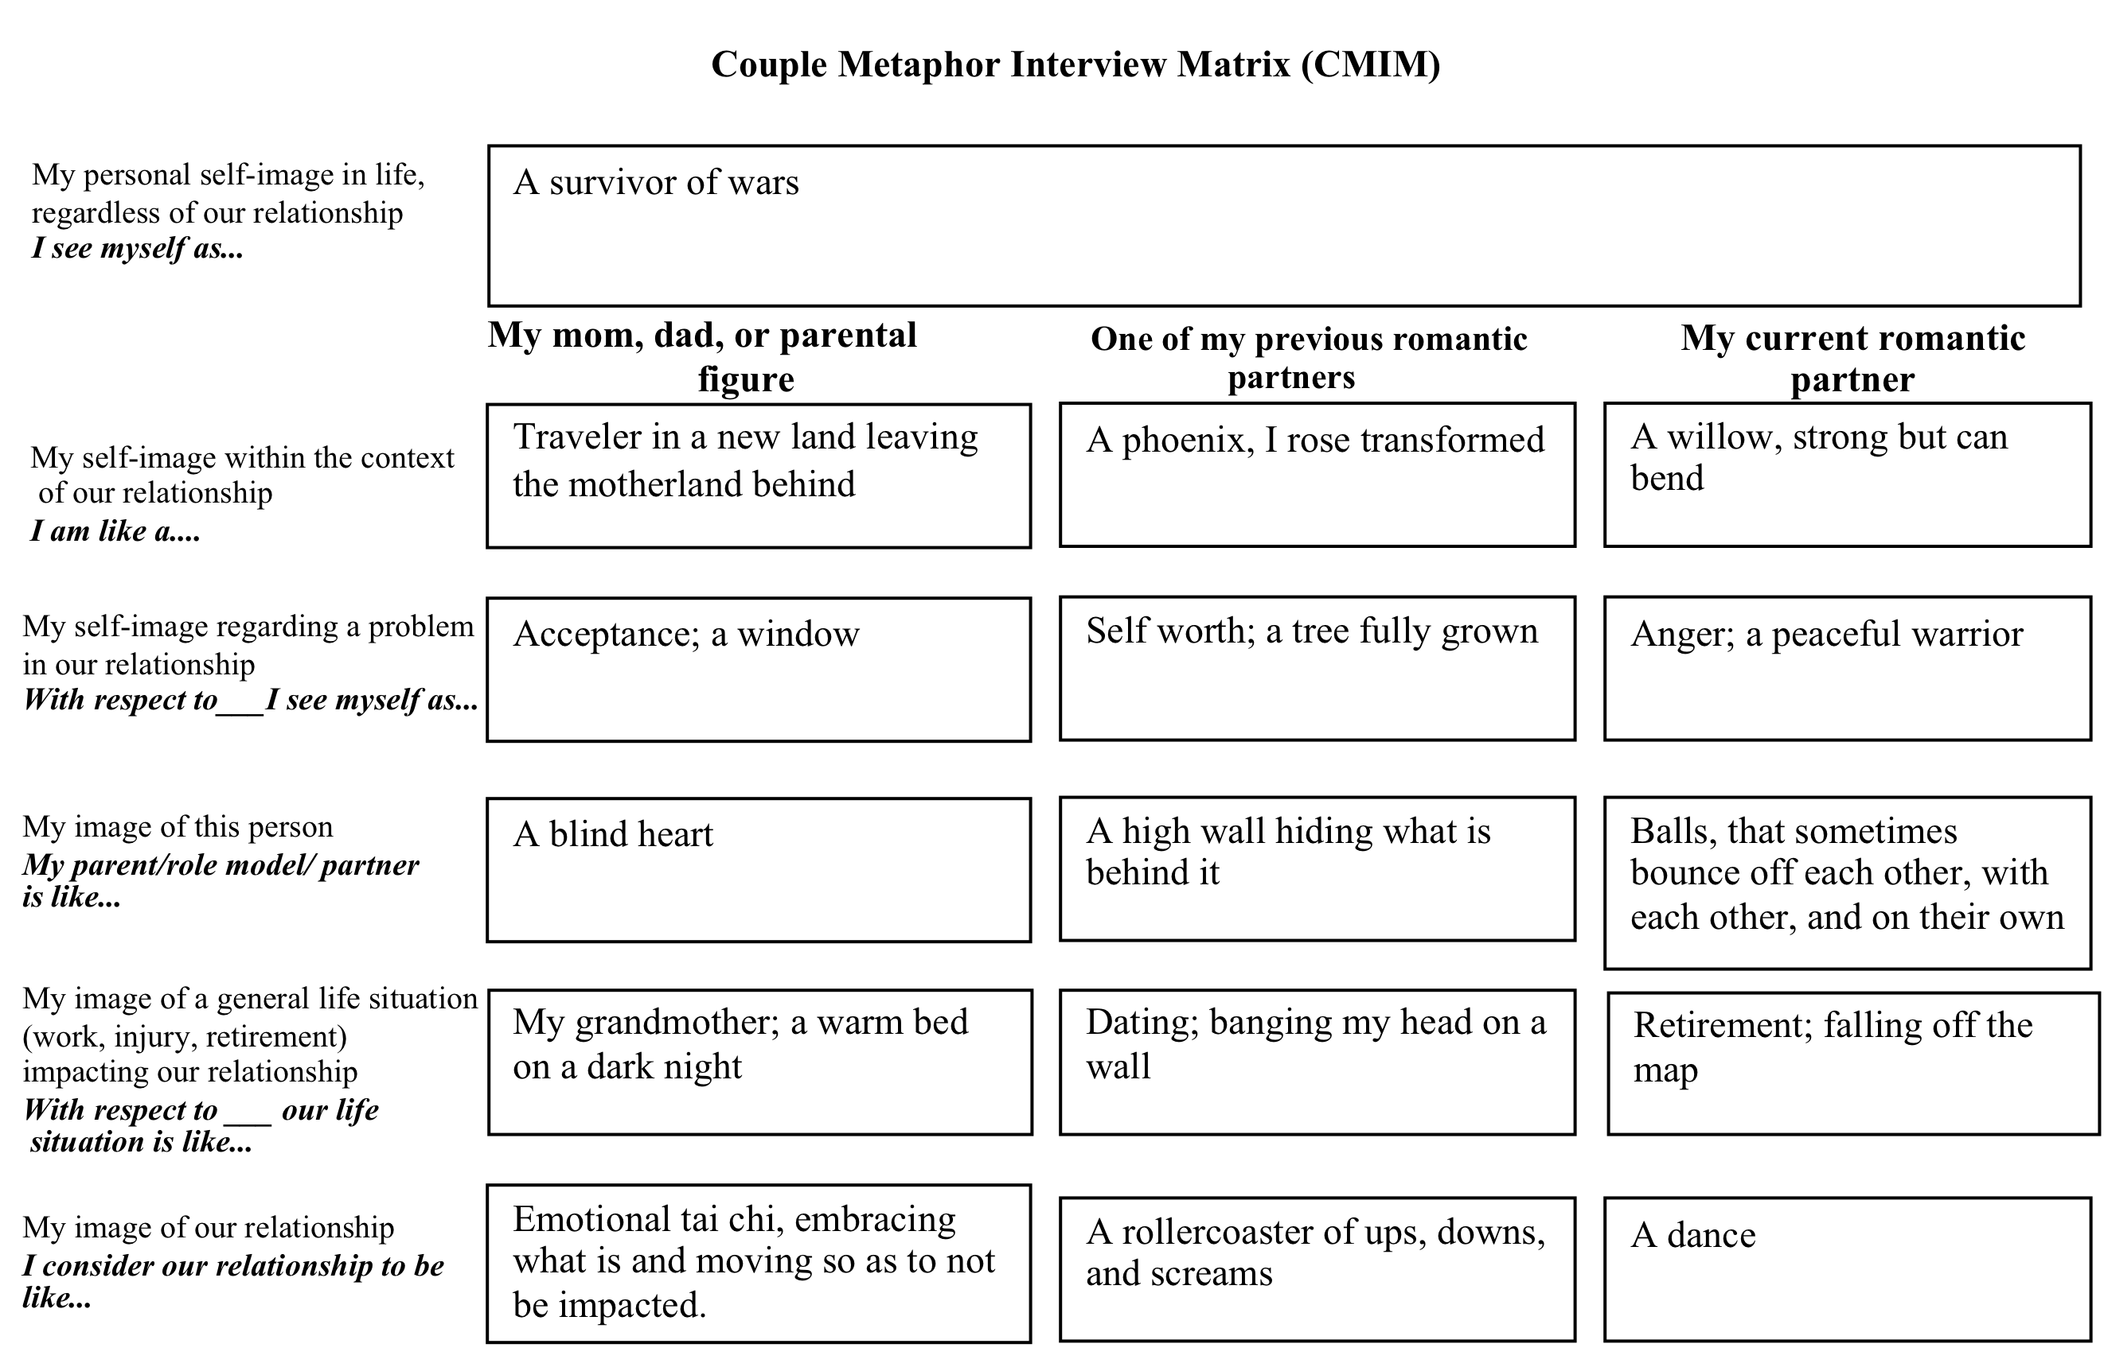
Partner A

Slide 25
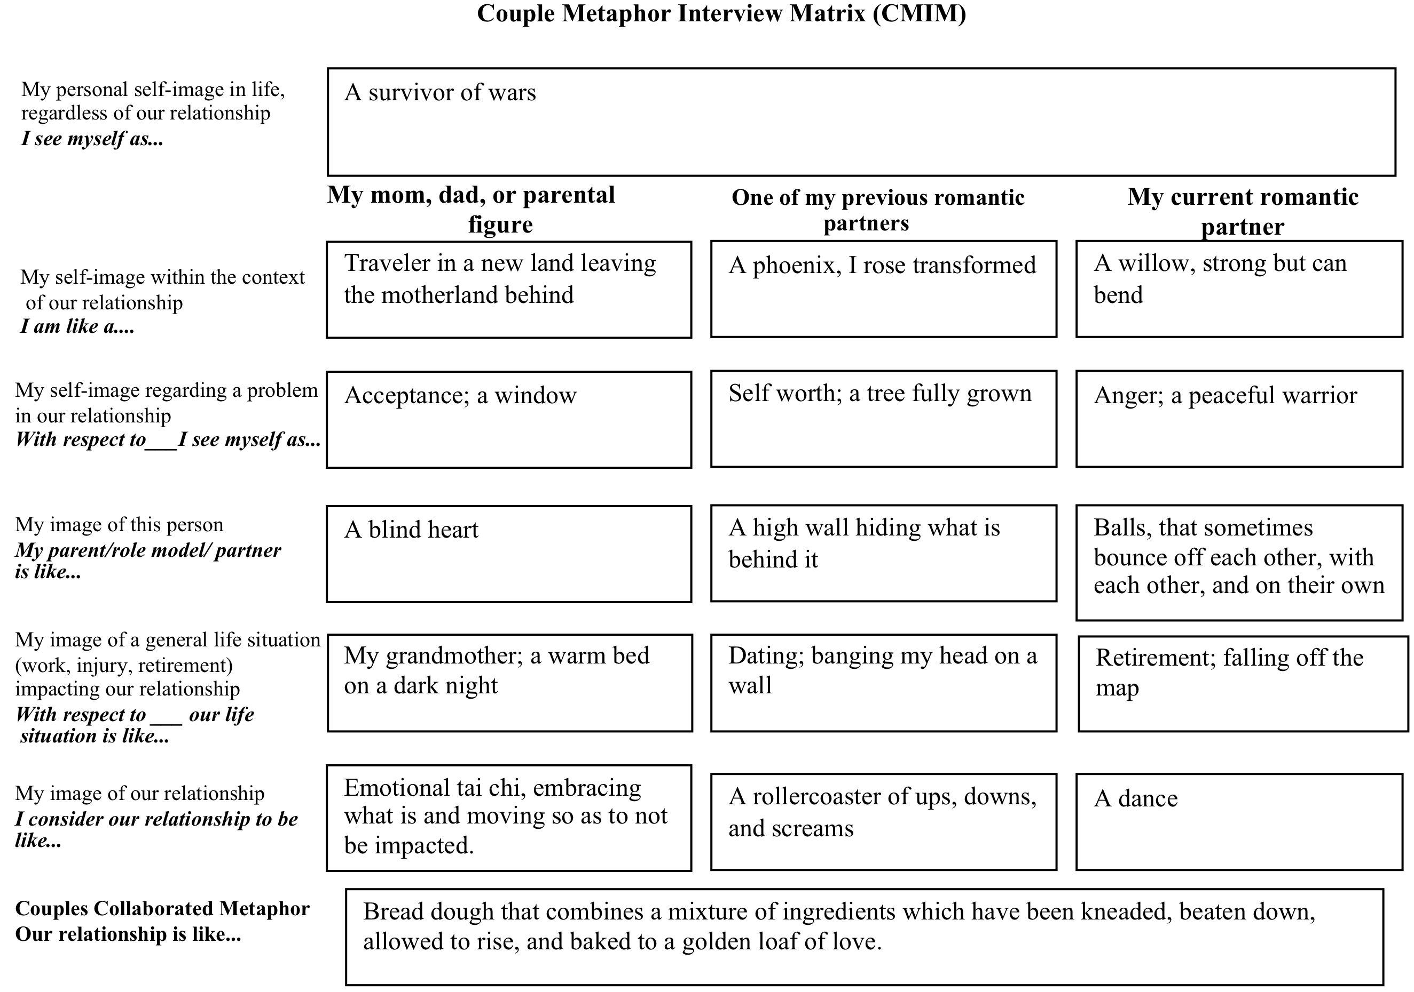
Partner B

Slide 26
More Examples…
Category I
I see myself as a dissonant note, pleasing surprisingly out of sync to the listener
Category 2
I am like receptacle but don’t know how to empty
Category 3
With respect to consistency in our relationship, I see myself as taffy, malleable, hard, stretchable and hard to swallow, sweet and fun.
Category 4
My mother is like an octopus with many arms and suctions to suck you in and never let go. She can’t let go, she doesn’t know how to release her prey.
Category 5
With respect to suffering it’s like a hated friend that keeps coming by to visit but it would be rude not to invite her in.
Category 6
With respect to graduate school it’s like a good piece of chocolate that doesn’t last until the next one is delivered and the sweetness has lost it’s appeal.

Slide 27
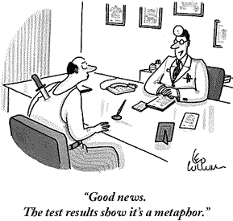
Are you ready to create your own metaphors?

Slide 28
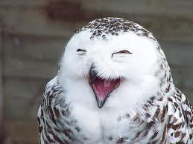
Summary and Conclusion
Questions and Comments
Thank you for joining our presentation!

Slide 29
References
Baxter, L.,A. (2003). Relationship metaphors. Retrieved from http://culturopoiesis.blogspot.com/2007/06/relationship-metaphors-by-leslie-baxter.html.
Eckstein, S., Straub, J., Russo, N., & Eckstein, D. (2012). Into the woods: Introducing the couples metaphoric interview matrices. The Family Journal: Counseling and Therapy for Couples and Families, 20(1), 1-9.
Ephron, N. (Producer). Reiner, R. (Director). (1989). When Harry Met Sally. [Motion Picture]. United States: MGM.
Joffe, C., H. & Rollins, J. (Producer), & Allen, W. (Director). (1977). Annie Hall [Motion Picture]. United States: MGM.
Kopp, R. & Eckstein, D. (2004). Using early memory metaphors and client-generated metaphors in Adlerian Therapy. Journal of Individual Psychology, 60(2), 163-174.
Kopp, R., R. (1995). Metaphor therapy: Using client-generated metaphors in psychotherapy. New York: Brunner/Mazel.
Mosak, H. (2002). Adlerian psychotherapy. In Raymond Corsini &
Danny Wedding (Eds.), Current psychotherapies (pp. 56-107). Itasca, IL: F. E. Peacock.
Shulman, B., & Mosak, H. (1988). Manual for lifestyle assessment. Muncie, IN: Accelerated Development.

